Slide 1
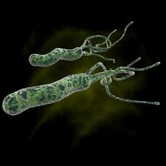
Helicobacter Pylori and Gastric Carcinoma
George Hawkins &
Crystal Carmines

Slide 2
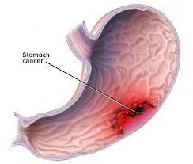
Question
How does Helicobacter Pylori (H. Pylori) contribute to the development of gastric carcinoma?

Slide 3

What is H. Pylori?
H. Pylori is a spiral shaped, Gram-negative, microaerophilic bacterium with unipolar flagella capable of inhabiting gastric mucosa.
In 1994, the International Agency for Research on Cancer of the World Health Organization concluded that H. Pylori is a Class I carcinogen involved in gastric cancer.
Gastric Cancer is the 2nd most common cancer worldwide.

Slide 4

What is H. Pylori?
H. Pylori bacteria was discovered in Perth (W. Australia) in 1979 by a pathologist named Robin Warren.
In 1982, under Warren’s guidance, an internist named Barry Marshall traced both ulcers and gastric carcinoma to H. Pylori infection.

Slide 5
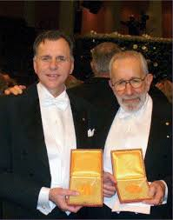
What is H. Pylori?
“We observed that everybody who got stomach cancer developed it on a background of gastritis…Whenever we found a person without H. Pylori, we couldn’t find gastritis”
In 2005, for their work on H. Pylori, Warren and Marshall were awarded a Nobel Prize.

Slide 6
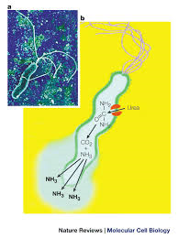
H. Pylori: Specific Adaptations
H. Pylori is specifically adapted to survive the hostile acidic gastric environment.
Using the Urease enzyme, the bacteria converts urea into ammonia and bicarbonate, which are strong bases, creating a protective neutralizing barrier around itself.

Slide 7
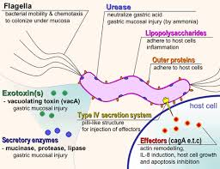
H. Pylori: Molecular Mimicry
Lipopolysaccharide(LPS) of H. Pylori contains O-antigen structures, which resemble human glycosphingolipids due to the presence of common carbohydrate residues.
LPS contains structures like Lewis X and Lewis Y antigens, which are similar to antigens of human blood groups, and also occur in the human gastric epithelium.
This enables H. Pylori bacteria to escape the host immune response.
The specific structure of H. pylori LPS is crucial for the adhesion to epithelial cells and gastric colonization.

Slide 8
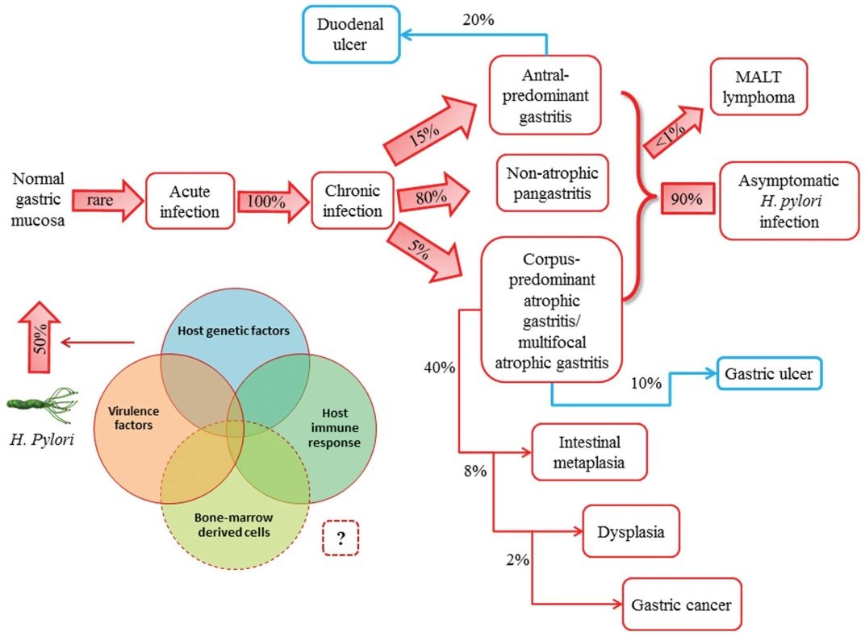
Exposure to H. Pylori
According to the CDC, H. Pylori is estimated to colonize the stomach in approximately two-thirds of the world’s population.
Infection is typically acquired during infancy.
Up to 90% of infected individuals may remain asymptomatic.
Infected persons have a 2- to 6-fold increased risk of developing gastric cancer and mucosal-associated-lymphoid-type (MALT) lymphoma.

Slide 9
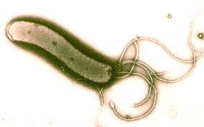
Exposure to H. Pylori
It is not known how H. Pylori is transmitted or why some individuals become symptomatic while others do not.
The clinical course of H. Pylori infection is highly variable depending on bacterial (genetic and immune) host factors.
Most likely route of transmission is fecal-oral or oral-oral.

Slide 10
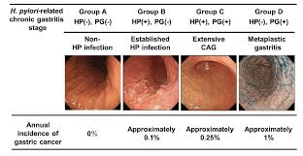
H. Pylori: Mechanism of Action
The chronic inflammation of the gastric mucosa associated with H. Pylori infection slowly progresses through pre-malignant stages to gastric carcinoma.

Slide 11
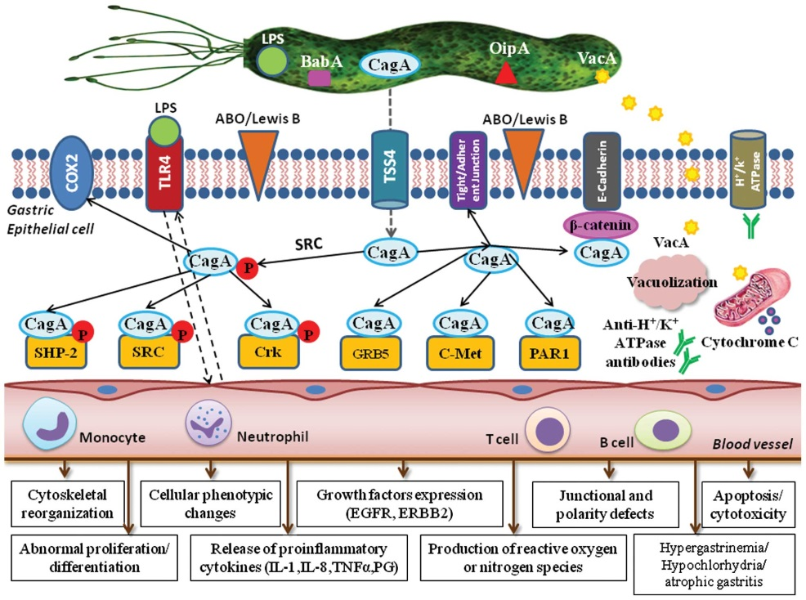
H. Pylori: Mechanism of Action The pathogenesis of H. Pylori is determined by a wide spectrum of virulence factors.
Virulence Factors
~Secreted into the bacterial extracellular environment
CagA
VacA
Enzymes secreted (Urease, aliphatic amidase, catalase oxidase, superoxide dismutase, phospholipases, glycosulfatase, and proteolytic enzymes)
~Associated with bacterial surface
Outer membrane proteins
Adhesins
Flagella
LPS

Slide 12
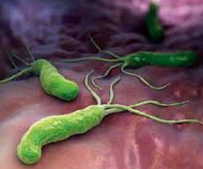
H. Pylori: Mechanism of Action
Virulence Factors ~secreted into extracellular environment
CagA-
Highly immunogenic protein encoded by cytotoxin associated gene
Stimulates epithelial production of cytokines- IL-8, IL-6, IL-1β, and tumor necrosis factor α (TNF- α)
Changes to host cell proliferation, motility, and polarity
VacA- vacuolating cytotoxin A
Involved in various mechanisms of programmed cell death (apoptosis and necrosis) in the target host cells

Slide 13
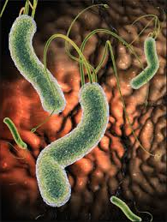
H. Pylori: Mechanism of Action
Virulence Factors ~secreted into extracellular environment
Enzymes secreted
Urease and aliphatic amidase- alter pH of evironment surrounding bacterium
Catalase, oxidase, and superoxide dismutase- protect bacterial cells from phagocytosis
Phospolipases A2 & C andglycosulfatase-damage cells of the mucous memebrane
Proteolytic enzymes-gastric mocous degradation

Slide 14
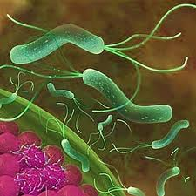
H. Pylori: Mechanism of Action
Virulence Factors ~Associated with Bacterial Surface
Outer membrane inflammatory protein A
Induction of mucosal cytokines and mucosal inflammation
Adhesins
Involved in colonization and interactions between bacterium and host cell surface
Flagella
Allow H. Pylori to move to regions of higher pH and necessary for colonization.
LPS
Molcular mimicry allowing adhesion to epithelial cells

Slide 15
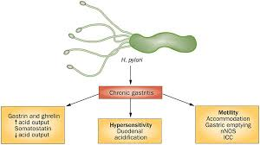
H. Pylori: Mechanism of Action
The ability to stimulate gastrin production is an important aspect of H. Pylori associated cancerogenesis.
Hypergastrinemia is associated with the overexpression of certain growth factors, the COX-2-prostaglandin system, and anti-apoptic proteins, leading to the proliferation of mutated atrophic cells, enhanced angiogenesis, and the development of gastric tumors.

Slide 16

Tests for H. Pylori Infection
Urea Breath Test * Best Option
94% sensitivity
95% specificity
Stool Antigen Test
91% sensitivity
93% specificity
Immunological Tests
80-84%

Slide 17
Treatment & Elimination of H. Pylori
The aim of H. Pylori eradication therapy is to restore the inflamed mucosa to a healthy state, or to prevent further progression of advanced chronic lesions.
Therapeutic regimens including 3 types of drug
-Antisecretory - proton-pump inhibitors
-Cytoprotectants-bismuth salt containing drug
-Antibiotics-clarithromycin, amoxiciilin, metronidazole, tetracycline, levofloxacine)

Slide 18
Treatment & Elimination of H. Pylori
First line allopathic regimen:
Triple therapy-(proton-pump inhibitors + amoxicillin + clarithromycin)
Metronizadole in association with proton-pump inhibitors and amoxicillin (in clarithromycin resistant individuals- <15-20% of population)
Second line allopathic regimen:
Quadruple Therapy-(proton-pump inhibitors + bismuth + subcitrate potassium + metronidazole + tetracycline)
Third line allopathic regimen:
Proton-pump inhibitor + amoxicillin + levoflaxin

Slide 19

Natural Treatment & Elimination of H. Pylori
Essential oils are beneficial in the fight against H.Pylori, fighting against both infection and against relapses.
Oils with anti-infective properties are essential oils with Phenol, such as oil of Oregano or Thymol, such as Thyme oil, Tea Tree Oil, and Cinnamon Oil .
Clove Oil inhibits the growth of H. Pylori.
There are essential oils with a significant anti-inflammatory effect, rich in aldehydes, such as the Cinnamon Oil, or essential oil of Chamomile or Ginger Oil .
Tarragon Oil and Ginger Oil has antispasmodic action.
Several oils such as the Mint (Mentha piperita) Oil and Lemon Grass Oil showed inhibition in vitro proliferation of H. Pylori.

Slide 20



Natural Treatment & Elimination of H. Pylori
Some isoflavones inhibit the growth of H. Pylori such as Glycine, Alfalfa, and Black Cohosh .
Some Brassicaceae like Cabbage or Broccoli contains glucosinolates that are converted by the action of an enzyme in sulforaphane. This enzyme was shown to inhibit the growth of H. Pylori bacteria in 8 of 11 cases.
Blueberries have anti-infective action and allow better absorption of vitamin B12. High molecular weight polysaccharides from blueberry inhibit adhesion of H. Pylori to human gastric mucus.
Chamomile Oil has been shown to decrease dyspepsia and stomach acidity and the local anti-inflammatory action is well known and has been compared with that of proton pump inhibitors. Chamomile essential oil also showed inhibition of H. Pylori in vitro.

Slide 21

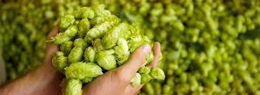
Natural Treatment & Elimination of H. Pylori
Gentian plant contains triterpenes and xanthones that have a direct anti-inflammatory action on the stomach lining.
Hops seem to have a calming effect on the stomach, although its mode of action has not yet been elucidated.
Probiotics and prebiotics The combination of prebiotics and probiotics provide benefits for the immune system; nondairy options are fermented food like miso, sauerkraut, and microalgae. Bifidobacteria, Saccharomyces and Lactobacillus have been studied and shown clearly better tolerance than the classic triple therapy.

Slide 22
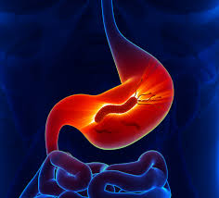
Conclusions
Eradication of Helicobacter Pylori is essential, in particular, to avoid the risk of stomach cancer. Classic eradication by allopathic treatment may not always be sufficient. Adding a natural treatment to standard treatment will limit the risk of relapse. Studies have shown that there are many plants that have a net action on Helicobacter Pylori and reduce risks.

Slide 23
Resources
Conteduca et al. "H. pylori infection and gastric cancer: State of the art (Review)." International Journal of Oncology International Journal of Oncology 42.1 (2013): 5-18.
http://wellnessbysilvia.com/2014/09/08/natural-treatments-for-helicobacter-pylori/
www.helico.com- The Helicobacter Foundation
http://www2c.cdc.gov/podcasts/player.asp?f=2738262
http://www.cdc.gov/ulcer/files/hpfacts.pdf.

